Slide 1
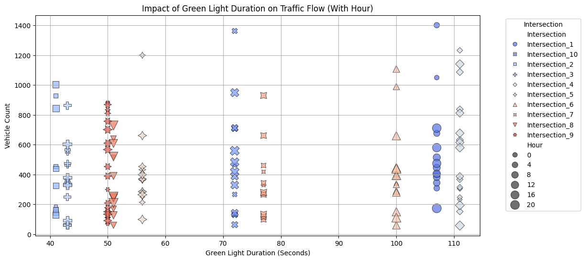
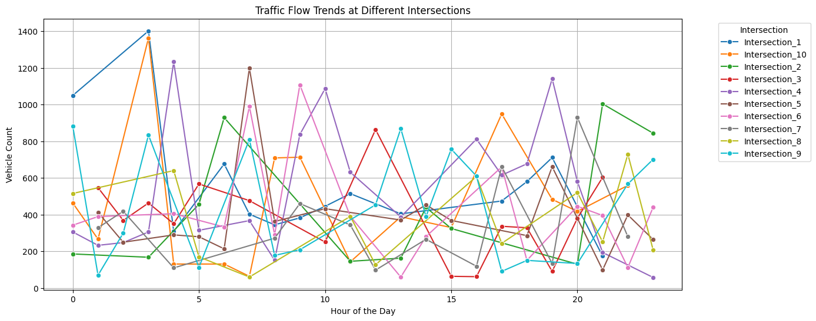
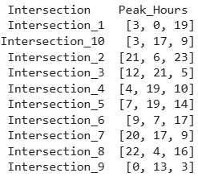
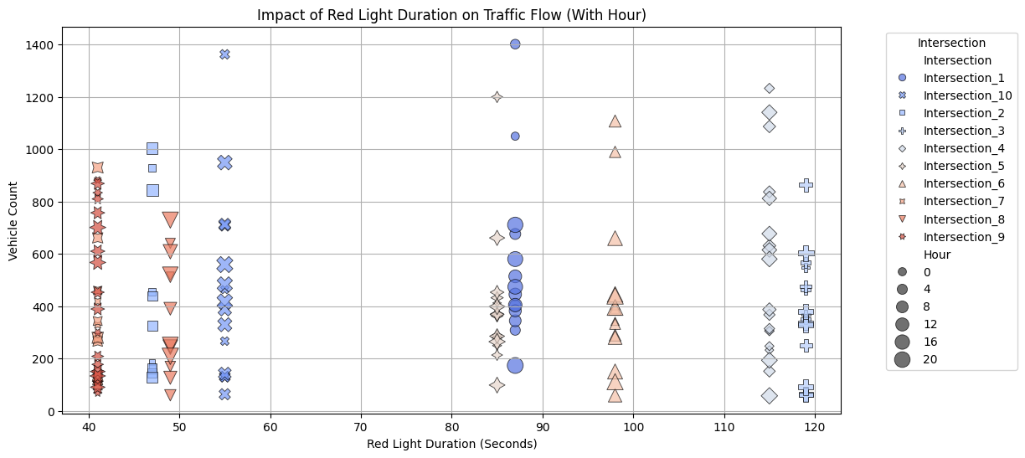
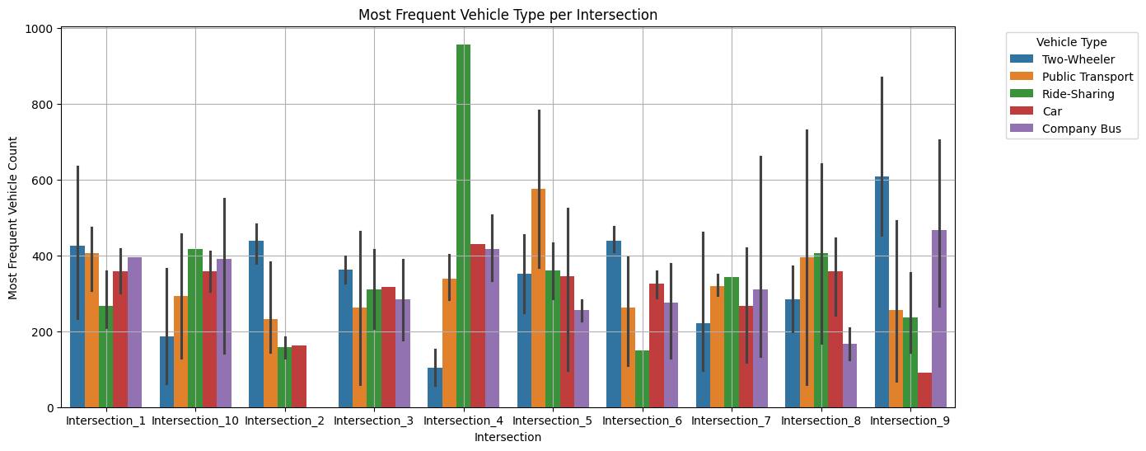
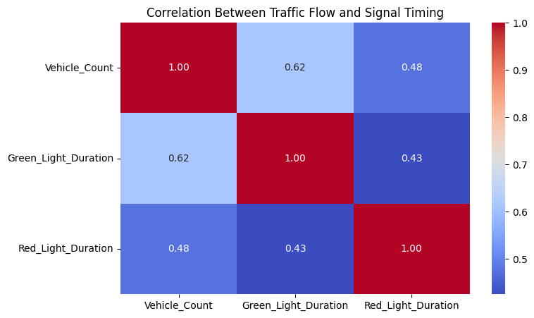
Aditya Shriwal (22BCE2132)
Link: Traffic.ipynb
Relationship between traffic flow and traffic signal timings.
Urban Traffic Flow Optimization
Intersection_4 , Intersection_6 : Efficiently managed signals help traffic move smoothly.
Intersection_2, Intersection_10 Shorter green lights may restrict flow, leading to potential congestion.
Intersection_3, Intersection_4 Long red lights cause buildup, slowing down overall movement.
Intersection_9 Shorter red lights allow more vehicles to pass through.
Patterns and trends in traffic flow at different intersections and times of the day.
The morning (7-10 AM) and evening (5-8 PM) peaks are the busiest times for traffic. Intersections 1, 6, and 9 see the highest congestion. Traffic signal optimization and alternate routes could help manage peak-hour congestion. Late-night hours (12 AM - 5 AM) show minimal movement according to the data given.
The above correlation explains that 62 %-time vehicle are passing green light signal and 48% wait in red light signal for total intersection.
I1: Two wheelers and company bus and transport are mostly observed : Employers and Commuters, I2: Employers are on two-wheelers but no Company Bus services. I3: Employers prefer two-wheelers and professional on car and same amount of people on ride share. I4: Riders are more here and then car and company bus which means that here can be EY's office. I5: Commuters and Professional. I6: Employers and Professional. I7: Balanced Number of vehicle count. I8: More Professional and commuters on ride share and public transport. I9: Employers are more here may be a Common Rental Place. I10: Professional and Employers on company bus.
High-Traffic Intersections is likely major roads, commercial areas, or busy urban centers. Low-Traffic Intersections is intersections may be in residential or less busy areas.

Slide 2
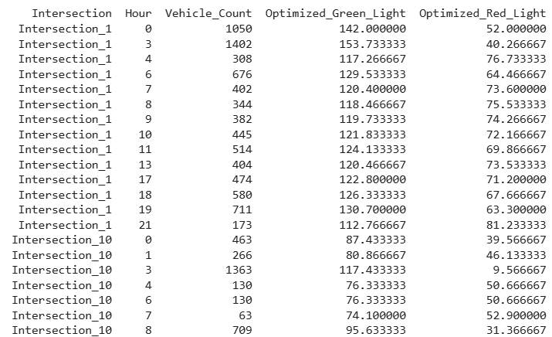
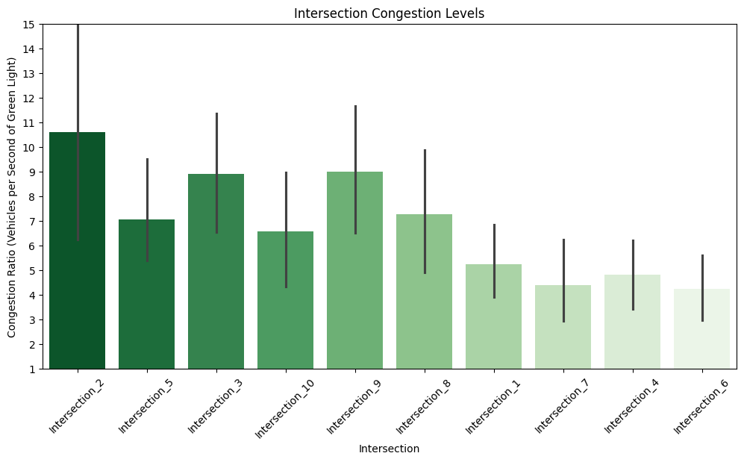
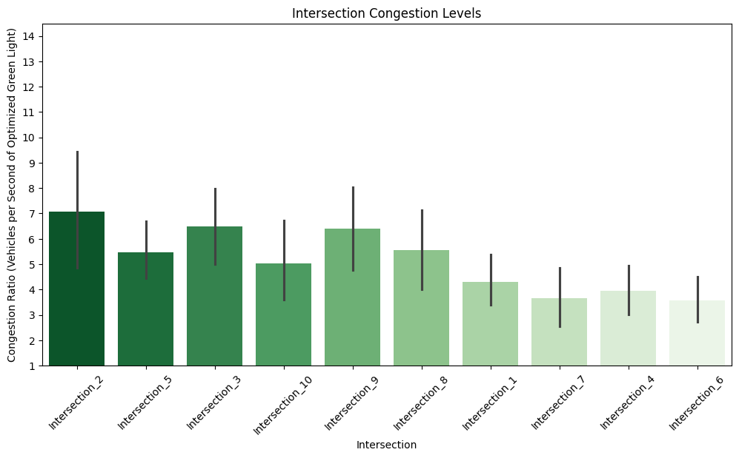
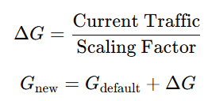

Aditya Shriwal (22BCE2132)
Optimization Strategy to improve traffic flow based on analysis
By Adjusting traffic signal timings, implementing adaptive traffic control systems, and optimizing intersection layouts. When there is peak hours the count of traffic police should increase.
ITS: For communication, sensing, and control technologies that manage traffic in real-time, ITS assumes the interpretation of traffic conditions using road sensors, GPS devices, traffic cameras, or other sources, updating traffic signal settings accordingly. ITS can reduce congestion, improve road safety, and enhance the effectiveness of public transportation systems.
Adaptive Traffic Signal Control: ATSC systems are basically the development and advancements of conventional traffic signal systems. Unlike pre-timed signals, ATSC systems change the signal timings according to real-time traffic data. The systems decrease waiting periods for automobiles and pedestrians and have been found very effective where at off-peak hours, the traffic volume varies.
Previous Congestion Graph
Optimised Congestion Graph
Proposed strategies with data-driven insights
Intersection 4 requires better ride-sharing . Intersection 1 & Intersection 8 need optimized two-wheeler lanes and carpooling measures. Public transport (bus, metro) expansion can further reduce traffic congestion across high-traffic intersections. Company bus routes should be expanded for improved employee commuting. Intersection 10 should have dedicated lane for heavy vehicle.
Here, we use sum of vehicle count by scaling factor for getting optimized time.
Delta Algorithm for optimizing the duration of traffic light based on vehicle count at each intersection point. The Congestion ratio decrease around by 35% by our algorithm.

Slide 3
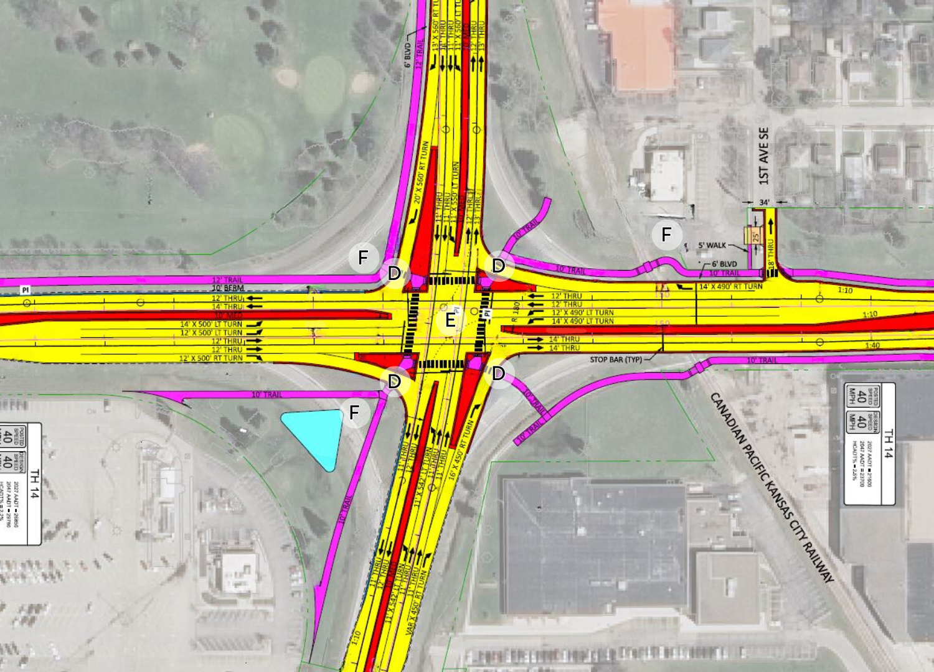
Aditya Shriwal (22BCE2132)
Final Conclusion Report
Adaptive Traffic Signal Control:
Dynamic Adjustments: By leveraging real-time vehicle count data, the adaptive signal control system adjusts green and red-light durations based on current traffic conditions. When vehicle counts exceed short-term (rolling) averages, the system increases the green light duration and decreases the red-light duration to facilitate smoother traffic flow. Conversely, during lower traffic periods, the adjustments ensure that signal timings are balanced.
Scalable Approach: Using a scaling factor allows for fine-tuning the sensitivity of these adjustments, ensuring that the system can be calibrated to local traffic patterns and specific intersection characteristics.
Optimized Intersection Layout:
Lane Recommendations: By analyzing the average hourly vehicle counts at each intersection, the model recommends the optimal number of lanes. A simple heuristic-dividing the average vehicle count by an assumed lane capacity (e.g., 500 vehicles per hour) and applying ceiling functions-yields a practical recommendation for adding lanes, subject to predefined minimum and maximum constraints.
Integrated Benefits:
Enhanced Traffic Efficiency: The combination of adaptive signal control and optimized physical layouts is designed to reduce delays, clear congestion more effectively, and improve overall road throughput.
Data-Driven Decision Making: Our approach leverages real-time and historical traffic data to inform both dynamic signal adjustments and infrastructure planning, ensuring that interventions are grounded in actual traffic patterns.
Optimized Intersection
Github link: https://github.com/Aditya-devop/Urban_Traffic_Analysis_Flow_Optimisation

